Slide 1
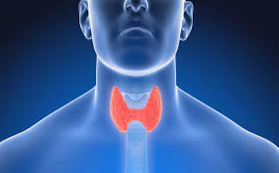
Interesting case
Diagnosis : Left thyroid nodule
Operation : Transoral endoscopic thyroidectomy
R2 Jutamas Srisung
Advisor : Col.Siriluk Chumnanvej

Slide 2
History
Case ผู้ป่วยหญิงไทย อายุ 60 ปี
Chief complaint : มีก้อนที่คอด้านซ้าย 3 ปี ก่อนมา รพ.
Present illness :
3 ปีก่อนมารพ. คลำพบก้อนที่คอด้านซ้าย คลำก้อนได้ขนาด 2 cm ก้อนขนาดเท่าๆเดิม ไม่มีอาการเจ็บบริเวณก้อน ก้อนขนาดเท่าๆเดิม จึงมารพ. ที่รพ. Ultrasound thyroid พบ heterogenous mass at lt.lobe of thyroid, size 1.7x2.0 cm , FNA: Benign nodule with cystic degeneration จึงนัดมาผ่าตัด

Slide 3
History taking ? R1

Slide 4
History
ไม่มีอาการเสียงแหบหรือกลืนลำบาก
ไม่มีอาการกินจุ น้ำหนักลด
ไม่มีอาการใจสั่นผิดปกติ
ปกติแข็งแรงดี ทำงาน ออกกำลังกายได้ตามปกติ

Slide 5
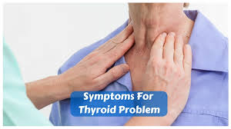
Past history
No underlying disease
No drug allergy
No history of surgery
No history of smoking or drinking alcohol

Slide 6
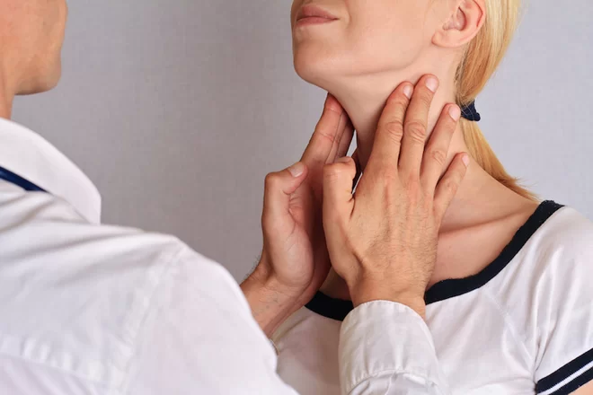
Physical examination R1

Slide 7
Physical examination
A Thai woman , good consciousness
BW : 50 kg , Height 150 cm, BMI : 22.22 kg/m²
HEENT : not pale, no jaundice
- Lt thyroid nodule size 2 cm , soft , not tender , firm consistency ,move by swallowing
- LN were impalpable

Slide 8
Physical examination
Airway examination :
Limit neck of motion : No
Thyromental distance > 6 cm
Mouth opening > 3 cm
Upper lip bite test : grade 1
Prominent incisor : No
Mallampati grade : grade 2

Slide 9
Physical examination
Pulmonary : no dyspnea ,no tachypnea , equal breath sound both lungs
CVS : Pulse full & regular ,no heaving, no thrill, normal S₁&S₂, no murmurs
Abdomen : soft, not tender, liver & spleen can not palpable
Extremities : no deformity, no pitting edema
Neuro : E₄M₆V₅, orientation to time place person , motor gr V all

Slide 10
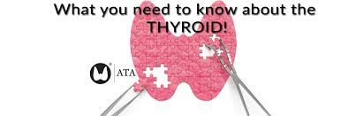
Investigation R1

Slide 11
Investigation
CBC: Hb 13.1 gm/dl, Hct 39 %, Platelet 242,000/mm³
WBC 7800 cell/mcL
Electrolytes: Na 144, K 3.76, Cl 101.5, CO₂ 26.7
BUN: 12.6 mg/dL Cr: 0.62 mg/dL
Anti HIV : negative
TFT : TSH 1.74 mUI/ml (normal)
FT4 1.38 ng/mL (normal)
FT3 1.70 pg/ml (normal)

Slide 12
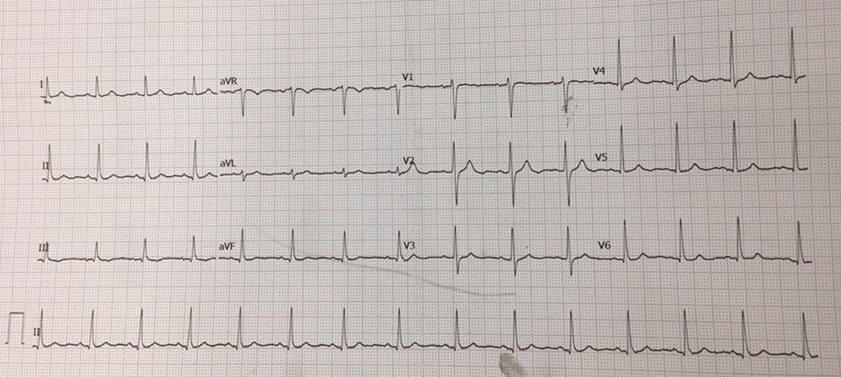
Ekg
NSR, regular rate, HR 75 bpm , no chamber hypertrophy , no LVH , no ischemic pattern

Slide 13
Problem list R1

Slide 14
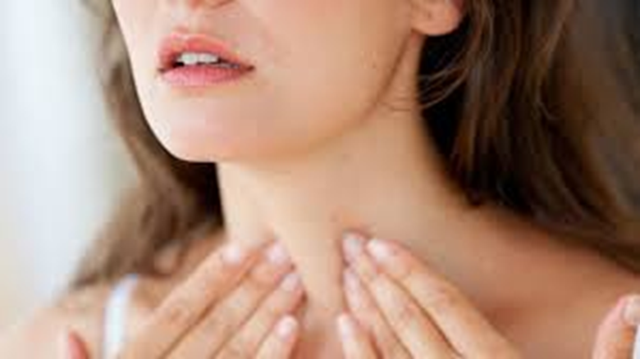
Problem list
1. Left thyroid nodule
Op: Transoral endoscopic thyroidectomy

Slide 15
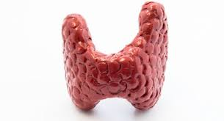
Preoperative evaluation R2

Slide 16
Preoperative evaluation
Left thyroid nodule
- mass size 1.7 x 2 cm at Lt lobe of thyroid
- no clinical of pressure symptom
- nerve intact all : no clinical of hoarseness
- thyroid function test : euthyroid
- preoperative investigation : normal all
- no sign of difficult airway

Slide 17
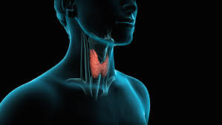
ASA classification
ASA class I

Slide 18
Preoperative preparation R2

Slide 19
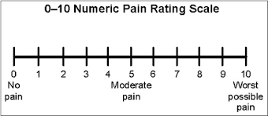
Preoperative preparation
Patient identification
Verification of procedure and care
Medical problem
VAS of pain
Notes:
Verification of procedure and care : อธิบายข้อมูลและวิธีการทำการผ่าตัด การเตรียมตัวทั้ง preop intraop post op แผลอยู่ที่ริมฝีปากล่างด้านใน การผ่าตัดทำโดยใช้ การส่องกล้อง
Post op อาจมีบริเวนคอบวมได้

Slide 20
Preoperative preparation
NPO
Inform Consent
Warm IV fluid
Force air warmer
No G/M blood component
5%DN/2 1000 ml iv 80 ml/hr

Slide 21
Trans Oral Endoscopic Thyroidectomy Vestibular Approach (TOETVA)
Notes:
มารู้จัก transoral endoscopic thyroidectomy vestibular approach เปนการผ่าตัดโดยใช้การส่องกล้อง มีประโยชน์มากในผู้ป่วยที่อายุน้อย ผู้หญิง ที่กลัวมีปัญหาด้วย cosmetic

Slide 22
Trans Oral Endoscopic Thyroidectomy Vestibular Approach (TOETVA)
Endoscopic thyroidectomy, originally introduced during the mid-1990s
recently gained popularity among various health care facilities for its obvious cosmetic advantages
Transoral thyroid surgery was first practiced in animal and cadavers
Excellent cosmetic outcome
Transoral endoscopic thyroid surgery, world journal of endocrine surgery, May-August 2016

Slide 23
Trans Oral Endoscopic Thyroidectomy Vestibular Approach (TOETVA)
The features that make TOET attractive are the
shorter duration of surgery
minimal blood loss
fewer complications
quick recovery
lesser duration of hospital stay and no surgical scar
Fewer wound related complications
Transoral endoscopic thyroid surgery, world journal of endocrine surgery, May-August 2016

Slide 24
Patient selection
No suspicion of malignancy
A fine-needle aspiration cytology report of a benign thyroid lesion
Thyroid goiter or nodules <5 cm in diameter
Thyroid gland volume <25 ml
No clinical of thyroiditis , hyperthyroidism
No previous neck surgery
No irradiation
-Transoral endoscopic thyroid surgery, world journal of endocrine surgery, May-August 2016
-Endoscopic vs. conventional thyroidectomy for the treatment of benign thyroid tumors: A retrospective study of a 4-year experience ; DOI: 10.3892/etm.2011.267

Slide 25
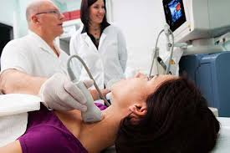
Preoperative preparation
All patients were adequately evaluated with routine investigations for surgery
Thyroid function test
ultrasound or CT scan of neck
Transoral endoscopic thyroid surgery, world journal of endocrine surgery, May-August 2016

Slide 26
Preoperative preparation
FNA thyroid nodule for diagnosis and rule out malignancy
Adequate control of preoperative comorbid conditions
Instructed patient to mouthwash twice daily for three days (Chlorhexidine)
Transoral endoscopic thyroid surgery, world journal of endocrine surgery, May-August 2016
Notes:
ผลการทำ fna ค่อนข้างจำเป็นในผู้ป่วยที่มาทำ endoscopic thyroidectomy
ก่อนเข้ามาผ่าตัด ต้องมีการ advice pt mouthwash dก่อนมาผ่าตัด

Slide 27
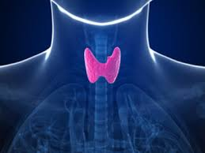
Choice of anesthesia

Slide 28
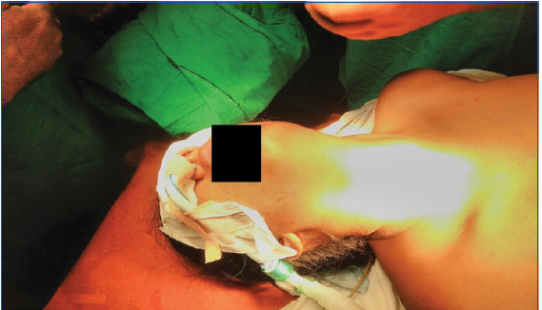
Choice of anesthesia
General anesthesia with ivory nasal endotracheal tube

Slide 29
Anesthetic consideration R3

Slide 30
Anesthetic consideration
Patient position
give full extension over the neck → concern C-spine injury
Evaluation C spine flex and extend in preoperative period
Confirm position of ETT
Secure nasal endotracheal tube with throat packing
For prevent aspiration
Rajendra D Patel et al., Anaesthetic Management in Transoral Endoscopic Thyroidectomy; Journal of Clinical and Diagnostic Research. 2017 Sep, Vol-11(9): UD07-UD08

Slide 31
Anesthetic consideration
Detect associated respiratory and hemodynamic changes from CO2 absorption
CO2 noncombustible , more soluble in blood and
capability for pulmonary excretion reduce the risk of adverse
outcomes in the event of gas embolism
Rajendra D Patel et al., Anaesthetic Management in Transoral Endoscopic Thyroidectomy; Journal of Clinical and Diagnostic Research. 2017 Sep, Vol-11(9): UD07-UD08
Notes:
Co2 ไม่ติดไฟ ละลายได้ในเลือด สามารถขับออกได้โดย pulmonary excretion

Slide 32
Physiologic effect
Hemodynamic response :
increase SVR and MAP caused by increased sympathetic output for CO2 absorption
Cardiac dysrhythmias (brady or tachycardia) → caused by hypercarbia, hypoxia, capnothorax, pulmonary embolism
Notes:
Depend on the interactions between the patient’s preexisting cardiopulmonary status and surgical
factors (magnitude of IAP, degree of CO2 absorption, alteration of patient position, and the type of surgical procedure)
•Anesthetic technique (minimal)

Slide 33
Physiologic effect
Neurohumoral response :
- activated sympathetic response with catecholamine release and renin-angiotensin system with vasopressin release
Notes:
การหลั่ง catecholamine and vasopressin ทำให้เกิด sympathetic response ได้

Slide 34
Anesthetic consideration
early detect hypercarbia :
Monitoring ETCO2 , ABG
Early detect complication
Subcutaneous emphysema
Pneumothorax
Gas embolism
Rajendra D Patel et al., Anaesthetic Management in Transoral Endoscopic Thyroidectomy; Journal of Clinical and Diagnostic Research. 2017 Sep, Vol-11(9): UD07-UD08
Notes:
- มีการ early detection of complication ; hypercarbia , pneumothorax โดย monitor etco2 , ABG

Slide 35
Intra operative management

Slide 36
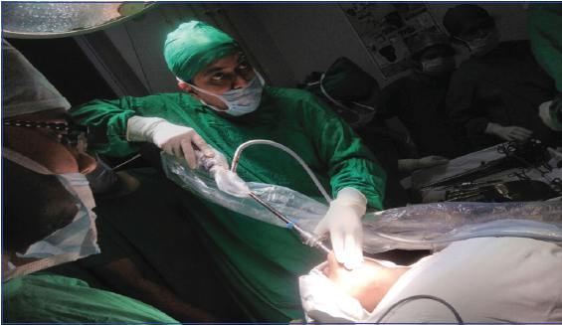
Intra operative management
Standard monitoring : pulse oximetry , NIBP , EKG , ETCO2, Temperature
Position : supine

Slide 37
time in OR 09.15 น.
Monitor
NIBP, EKG, O₂sat
BP at OR 160/90 mmHg
PR 110 / min

Slide 38
Preoxygenation
Induction & intubation:
Fentanyl 100 mcg IV
Propofol 120 mg IV
Cisatracurium 8 mg iv
ivory nasal endotracheal tube no 6.0 depth 26 cm
Start operation at 10.00 น.

Slide 39
Position
Supine position
At 30 degree reverse Trendelenburg position with adequate pillow under shoulder to give full extension over the neck
Head support by head ring
Both arms were adducted at shoulder joint
Transoral endoscopic thyroid surgery, world journal of endocrine surgery, May-August 2016

Slide 40
Notes:
Patient is in supine position with neck extended. Preformed ivory nasal endotracheal tube is fixed on the right side away from surgical site.
-At 30 degree reverse Trendelenburg position with adequate pillow under shoulder to give full extension over the neck

Slide 41
Intra operative management
Oral cavity was packed with povidone iodine gauge pack
Vestibule was cleaned twice with povidone iodine mouthwash lotion
Protect eye injury : padded both eyes
Throat pack : prevent aspiration
Rajendra D Patel et al., Anesthetic Management in Transoral Endoscopic Thyroidectomy
Journal of Clinical and Diagnostic Research. 2017 Sep, Vol-11(9): UD07-UD08

Slide 42
Vestibule incision

Slide 43
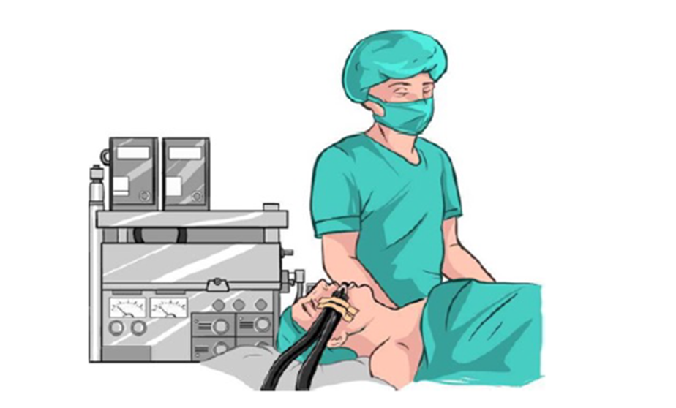
Intraoperative : maintenance

Slide 44
Maintainance: N2O:O₂:1:1
Sevoflurane 2 %
Dexamethasone 8mg at 10.00น.
Muscle relaxant:
- cisatracurium 6 mg
Analgesia :
- Fentanyl 100 mcg, Morphine 4 mg
- Dynastat 40 mg iv at 11.00น.
Antiemitic :
ondrasetron 8 mg IV
Operation time : 3hr

Slide 45
Incision and port placement
Three incision were made over the vestibular side of lip
one central 12 mm transverse incision in the midline
Two 5 mm incision were place at the level of canine teeth
Working space was created beneath the platysma
CO2 gas was inflated at 6 mm Hg pressure and flow 7 L/min in the subplatysmal plane
Rajendra D Patel et al., Anesthetic Management in Transoral Endoscopic Thyroidectomy
Journal of Clinical and Diagnostic Research. 2017 Sep, Vol-11(9): UD07-UD08
Notes:
Co2 ไม่ติดไฟและละลายในเลือด less complication

Slide 48
Intra operative management
Nitrous Oxide
Balanced anesthetic technique ( amnesia and analgesia )
• Reduce the requirements of inhaled and intravenous anesthetic drugs
• Controversial : PONV
- A meta-analysis of randomized controlled trials found that the emetic effect of N2O is not significant, and omitting N2O may increase the risk of awareness
Notes:
ในการผ่า endoscopic lสามารถใช้ no2 ได้

Slide 49
Intra operative management
Closely check on ETCO2 , a rising trend was noted and the highest reading encountered was of 40 mmHg.
Absorption of CO2 during extraperitoneal insufflation is higher than intra-peritoneal insufflation , it continue to increase progressively throughout extraperitoneal CO2 insufflation.
Clinical anesthesia 7th edition ;anesthesia for laparoscopic and robotic surgeries
Notes:
CO2 insufflation in abdominal laparoscopic surgeries ranges from 10 mmHg-15 mmHg which can lead to rise in ETCO2

Slide 50
Intra operative management
arterial blood gas analysis done one hour postinduction was within normal limits.
During procedure , recurrent laryngeal nerve was identified and preserve
Rajendra D Patel et al., Anaesthetic Management in Transoral Endoscopic Thyroidectomy; Journal of Clinical and Diagnostic Research. 2017 Sep, Vol-11(9): UD07-UD08

Slide 51
Intraoperative : emergence

Slide 52
Reverse : Prostigmine 2.5 mg ,Atropine 1.2 mg IV
Emergence : awake extubation
IV fluid : NSS 600 ml
EBL : minimal

Slide 53
Intraoperative complications

Slide 54
Cardiovascular compromise
Hypothermia
Intraoperative complications
Positioning
Surgical complication
CO2 insufflation
- Subcutaneous emphysema
- Capnothorax
- Capnomediastinum
- Capnopericardium
- Gas embolism
Sx. instrumentation
-acute haemorrhage

Slide 55
Intraoperative complications
Cardiovascular Complications
Arrhythmia : - bradyarrhythmia
- tachyarrhythmia
Alterations in arterial blood pressure
- hypotension
- hypertension
Notes:
สาเหตู DDX ; cardiac tamponade (capnomediastimum,) gas embolism , severe respiratory acidosis, acute blood loss
- เนื่องจาก co2 กระตุ้น sympathetic tone ; arrhythmia ,

Slide 56
Hypercarbia
procedure done in sites other than the abdominal/pelvic cavity, the absorption of CO2 continues to increase over time
resulting in hypercapnia and subcutaneous emphysema are worse than other laparoscopic surgery
Pressure of CO2 injection 6 mmHg prevented hypercarbia and enough to secure operative space
DDX : hypoventilation, airway obstruction, endobronchial intubation.
Anesthetic course and complications that were encountered during endoscopic thyroidectomy ; Korean J Anesthesiol 2012 October 63(4): 363-367
Notes:
During a laparoscopic abdominal surgery absorption of CO2 in the body continues to increase for the first 20 minutes until it levels out.

Slide 57
subcutaneous emphysema
subcutaneous emphysema in the neck and face may cause gas tracking in the thoracic area and mediastinum, resulting in pneumothorax and mediastinal emphysema
Predictor of subcutaneous emphysema
use of six or more surgical ports
operative time of > 200 minutes
high PetCO2 levels (50 mmHg or above)
Anesthetic course and complications that were encountered during endoscopic thyroidectomy ; Korean J Anesthesiol 2012 October 63(4): 363-367

Slide 58
subcutaneous emphysema
The emphysema is accompanied by increased airway pressure and elevated levels of PetCO2 → hypercapnia, respiratory acidosis
procedure resulted in the CO2 absorption three times the CO2 absorption observed where subcutaneous emphysema did not occur
If subcutaneous emphysema occur N2O must be discontinued , reduce gas injection pressure
Anesthetic course and complications that were encountered during endoscopic thyroidectomy ; Korean J Anesthesiol 2012 October 63(4): 363-367
Notes:
Subcutaneous emphysema มักมาคู่กับ aw pressure and etco2 ที่สูงขึ้น
เมื่อเกิด subcutaneous emphysema แล้ว co2 มักจะถูกabsorp ,มากขึ้น 3 เท่า
เกิด post operative hypercarbia

Slide 59
Pneumothorax
Symptom may increased PIP, decreased pulmonary compliance, increased PetCO2, decreased oxygen saturation, and hypotension
Management :
stop the infusion of CO2 or reduce the injection pressure
discontinue the use of N2O
increase hyperventilation and the fraction of inspired oxygen
maintain hemodynamic stability
Pleural puncture not need unless unstable respiratory, hemodynamic condition
May be necessary to convert to open procedure
Anesthetic course and complications that were encountered during endoscopic thyroidectomy ; Korean J Anesthesiol 2012 October 63(4): 363-367

Slide 60
Gas embolism
Carbon dioxide embolism is a rare but potentially fatal complication of anesthesia administered during laparoscopic surgery
Its most common cause is inadvertent injection of carbon dioxide into a large vein, artery or solid organ.
Carbon Dioxide Embolism during Laparoscopic Surgery
Yonsei Med J http://www.eymj.org Volume 53 Number 3 May 2012

Slide 61
Gas embolism
Clinical presentation of carbon dioxide embolism ranges from asymptomatic to neurologic injury, cardiovascular collapse or even death
dependent on the rate and volume of carbon dioxide entrapment
Notes:
-clinical occur at the beginning

Slide 62
Gas embolism
the initial presentation may be indicated by:
etCO2 – a fall of 2 mmHg
ECG – ST segment and T wave changes initially, followed by supraventricular and ventricular tachy-arrythmia , S1Q3T3
Hypotension progressing to PEA
Notes:
- S1Q3T3 : S wave in lead I , Qwave in lead III, inverted T in lead III (rt heart strain pattern )<20% of case
- ETCO2 : 2mmHg → not very specific ,if systemic hypotension
VAE : CVS :tachy-arrhymia , st t change ,mi ,rt heart failure
RS : co2 คั่ง, CNS : co decrease → cerebral hypoperfusion
-Co2 embolism may increase or decrease etco2

Slide 63
The Physiological Changes, Signs and Symptoms of Carbon Dioxide Embolism
Increase
Carbon Dioxide Embolism during Laparoscopic Surgery
Yonsei Med J http://www.eymj.org Volume 53 Number 3 May 2012
Notes:
co2 embolism : gas lock effect : cause obstruction of RV → increase PAP → rv failure
Decrease LV filing → co decrease → LV failure → cardiovascular collapse
Increase arterial partial pressure of co2
Co2 embolism may increase or decrease etco2

Slide 64
DIAGNOSIS
Diagnosis and Treatment of Vascular Air Embolism
Anesthesiology, V 106, No 1, Jan 2007
Notes:
Most sensitive non invasive monitors, Placed on rt or lt sternal border , 2nd – 5th ICS
- Precordial doppler : place in parasternal area 4th intercostal space over RA
- Pick up signal from RVOT (rt ventricular outflow tract)
* Limitation : artifact during use electrocautery , prone/lateral patient position , morbid obese
- Lethal dose : 600ml in 70 kg pt , LD 50= 1750 ml , continue infusion : 1.2 ml/kg/min , 72 ml/min in 60kg pt

Slide 65
DIAGNOSIS

Slide 66
Management of Carbon Dioxide Emboli
Carbon Dioxide Embolism during Laparoscopic Surgery; Yonsei Med J http://www.eymj.org Volume 53 Number 3 May 2012
Notes:
Lt lateral decubitus (Durant’s) position to allow gas bubbles to rise to the apex of the RA and to prevent entry into the pulmonary artery

Slide 67
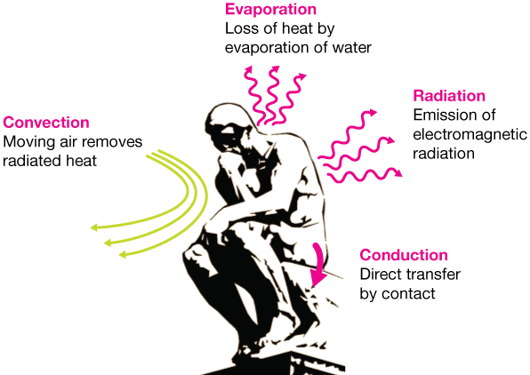
Hypothermia
- Heat loss occurs mainly by convection
- Dry CO2 (21 C)
Notes:
Body temperature regulation : conduction (การนำความร้อน) สัมผัส ,
convection การพา พาความร้อนไปสู่บรรยากาศที่เย็นกว่า ลมพัด เครื่องปรับอากาศ
Evaporation การระเหย เมื่อสูญเสียความร้อน โดยการเปลี่ยนจากน้ำเป็นไอ
radiation การแผ่รังสี

Slide 68
Endoscopic vs. conventional thyroidectomy for the treatment of benign thyroid tumors: A retrospective study of a 4-year experience ; DOI: 10.3892/etm.2011.267

Slide 69
Post operative considerations
Pain prevention
Factors that could influence postoperative pain include ;
- duration of procedure,
- degree of gas pressure
volume of residual gas after surgery
Pain therapy for patients undergoing laparoscopic surgery —> multimodal analgesia techniques

Slide 70
Post operative considerations
PONV prevention
•PONV prophylaxis ;
- dexamethasone 4 - 8 mg
- 5-HT3 antagonists (ondansetron 4 mg)
- minimal opioid use

Slide 71
Post operative
S: ตื่นรู้ตัวปกติ ไม่มีไข้ ปวดแผลเล็กน้อย หายใจได้ดีไม่เหนื่อย ไม่มีคลื่นไส้อาเจียน
O: V/S : BP 150/90 , PR 60/min RR 18/min
BT 36.6C
HEENT : no subcutaneous emphysema , mild neck swelling,
normal mouth opening
Cardiovascular : normal s1s2, no murmur, regular rate
Respiratory : room air o2sat 100 %, lungs clear both, no sign of upper airway obstruction
ext : no pitting edema

Slide 72
Post operative
A&P : clinical stable
Adequate pain control : tramol 50 mg iv prn q 8 hr ,
paracetamol (500) 1 tab oral prn q 4 hr
Amoxicillin-clavulanic acid (1gm) 1 tab op bid pc.
post operative nausea vomiting : odensetron 8 mg iv prn q 8 hr
Discharge day 2 after surgery

Slide 73
Incisional wound in the mouth has healed
There is no surgical scar on the patient’s neck without a drain hole

Slide 74
Patient satisfaction with cosmetic results.

Slide 75
Reference
Clinical anesthesia 7th edition ;anesthesia for laparoscopic and robotic surgeries
Endoscopic vs. conventional thyroidectomy for the treatment of benign thyroid tumors: A retrospective study of a 4-year experience ; DOI: 10.3892/etm.2011.267
Rajendra D Patel et al., Anaesthetic Management in Transoral Endoscopic Thyroidectomy, Journal of Clinical and Diagnostic Research. 2017 Sep, Vol-11(9): UD07-UD08
Transoral endoscopic thyroid surgery, world journal of endocrine surgery, May-August 2016

Slide 76
Reference
Transoral endoscopic thyroidectomy: A case report ; International Journal of Surgery Case Reports 12 (2015) 99–101
Transoral endoscopic thyroidectomy vestibular approach (TOETVA) for Graves’ disease: a comparison of surgical results with open thyroidectomy ; Gland Surg 2016;5(6):546-552
Anaesthetic Management in Transoral Endoscopic Thyroidectomy; DOI: 10.7860/JCDR/2017/27889.10618
Anesthetic course and complications that were encountered during endoscopic thyroidectomy; Korean J Anesthesiol 2012 October 63(4): 363-367

Slide 77
Thank you for your attention**

